Slide 1
A Worldwide Celebration!
October 3, 2017

Slide 2
CX Day
CX Day is a global celebration of the organizations, CX professionals and employees who create great experiences for every customer, every day!
CX Day was established in 2013 by the Customer Experience Professionals Association (CXPA) so we are celebrating our 5th year!
You are joining thousands of people celebrating around the world!

Slide 3

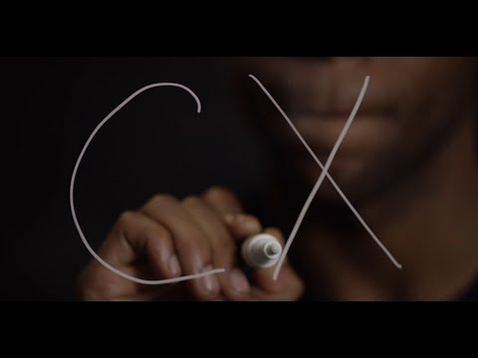
Notes:
We turn customer feedback into great companies. We capture feedback everywhere your customers are, connect it to everything else you know about them, and deliver insights and action in real-time. This allows your employees to make smarter, more informed daily decisions so you can deliver better business results. visit us at medallia.com

Slide 4

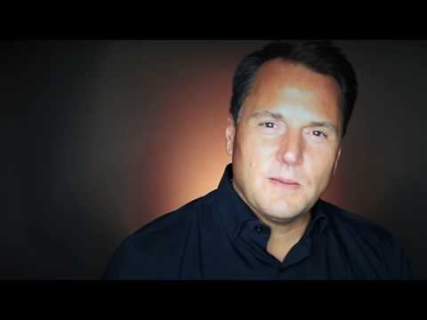
Notes:
Customerville has been a long-time player in enterprise feedback with clients ranging from international airlines to major healthcare providers.
You’ll know Customerville powered feedback when you see it. They bring together a unique blend of art, technology and behavioral science to make measuring the customer experience a part of the experience.
Visit them at Customerville.com for more information. Be sure to check out their co-hosted webinars!

Slide 5


Journey Analytics
IVROptimization
Total Voice-of-Customer
Digital Containment
Real-Time Personalization
Managed Analytics
Customer Success Team
NICE.com/CXA
Notes:
Founded in 1986, NICE is grounded in 30+ years of customer service expertise.
Headquartered in Israel with US offices in Hoboken, NJ, NICE has over 25,000 customers located around the globe that consists of (85) Fortune 100 enterprise customers.
Comprised of 5 CX solutions supported by the Managed Analytics team, NICE cXa is able to monitor and analyze each customer engagement through predictive analytics, machine-learning, and intuitive algorithms that provide a 360 degree view of customer behavior and sentiment.
NICE cXa delivers service excellence across marketing, sales and contact center channels that drives operational efficiencies while improving the customer experience, in real time.
To learn more about Nice Customer Experience Analytics, please visit nice.com/cxa

Slide 6


North Highland takes an ecosystem approach to design and deploy meaningful interactions across channels – while building and embedding lasting CX capabilities. The result? Impactful experiences and organizations that are enabled to deliver real, sustainable results.
Customer Insights & Empathy | CX Strategy & Design | CX Enablement
Notes:
Also, special thank you to North Highland for serving as CXPA’s Gold Global Sponsor.
North Highland takes an ecosystem approach to design and deploy meaningful interactions across channels – while building and embedding lasting CX capabilities. The result? Impactful experiences and organizations that are enabled to deliver real, sustainable results.

Slide 7
The Customer Experience Professionals Association
Founded in 2011, the Customer Experience Professionals Association is the premier global, non-profit association dedicated to the enhancement and cultivation of the Customer Experience profession
We support the professional development of our members by:
  Sharing best practices, tools, resources and education
  Enhancing networking and community
  Establishing standards and
  Promoting our profession by creating a better understanding of the discipline of customer experience.

Slide 8

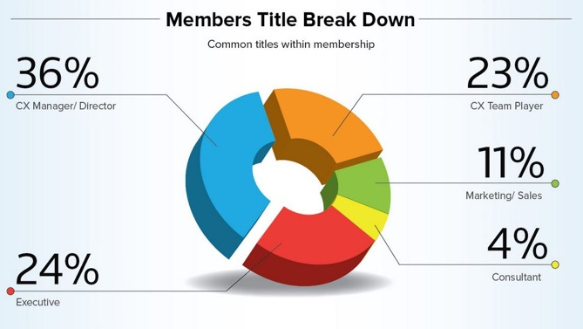
Our association represents many experience roles, skill levels and industries
4,000+ strong in over 70 countries
500+ Certified Customer Experience Professionals
60% of members are CX Managers/Directors or above

Slide 9
We are a by-member, for-member association
Hundreds of Local Networking events in over 60 cities across the globe
Resource library of CX examples and tools
Active Discussion Forum with dozens of posts everyday
Resource library of CX examples and tools
CX Expert Panel
CX Courses, webinars, podcasts
Career Development & Certification

Slide 10
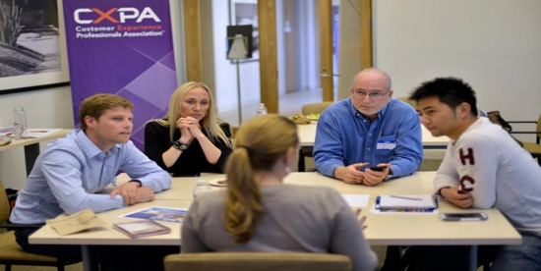
CXPA Local Networking Events
Local Meet-Ups are designed to:
  provide a personal and professional support network
  give you professional development opportunities in CX
  help you find answers to questions/best practices
  create a feeling of connection to other practitioners
  find help and support!

Slide 11

Driven by human needs and expectations…
75% of online customers expect a
5 minute response time to inquiries
- McKinsey & Company
44% of consumers know more about store products than associates -Saleforce

Slide 12


…the world is changing dramatically…
83% of consumers prefer human interaction
- Accenture
95% of consumers share poor customer experiences
- American Express

Slide 13


...and we can help you thrive!
99% of professionals agree CX is a GREAT profession to be in!
-Temkin Group
61% of CX Teams are
10 people or less
- Clarabridge

Slide 14
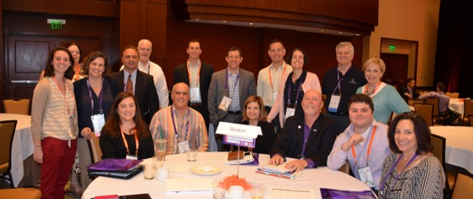
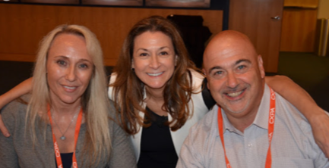
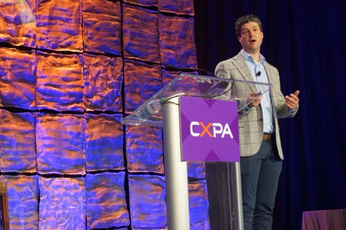
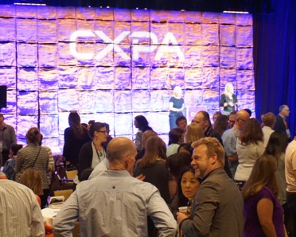
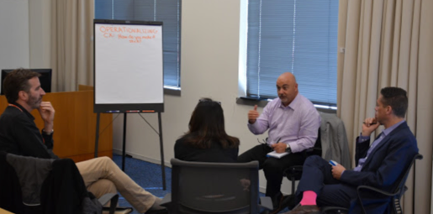
Join us in transforming Customer Experiences!
Visit cxpa.org/join/membership

